Slide 1
National Rural Employment Guarantee Act
(NREGA),
Power BI project
Ankitha Pawar

Slide 2
Dataset Information
The dataset used for this analysis is sourced from official government records and contains information
related to NREGA implementation across various states and districts in India. It comprises 28 columns,
encompassing data on job cards, worker details, budget allocation, work completion statistics,
expenditure, and more. This dataset offers a comprehensive view of the progress and challenges faced
by the NREGA program.

Slide 3
Total No. of Workers: 269M
Total No. of Active Job Cards: 97M
Approved Labour Budget: 2 B
Total No. of Active Workers: 175 M
Total No. of Works Takenup: 17M
Total No. of JobCards issued: 156 M

Slide 4
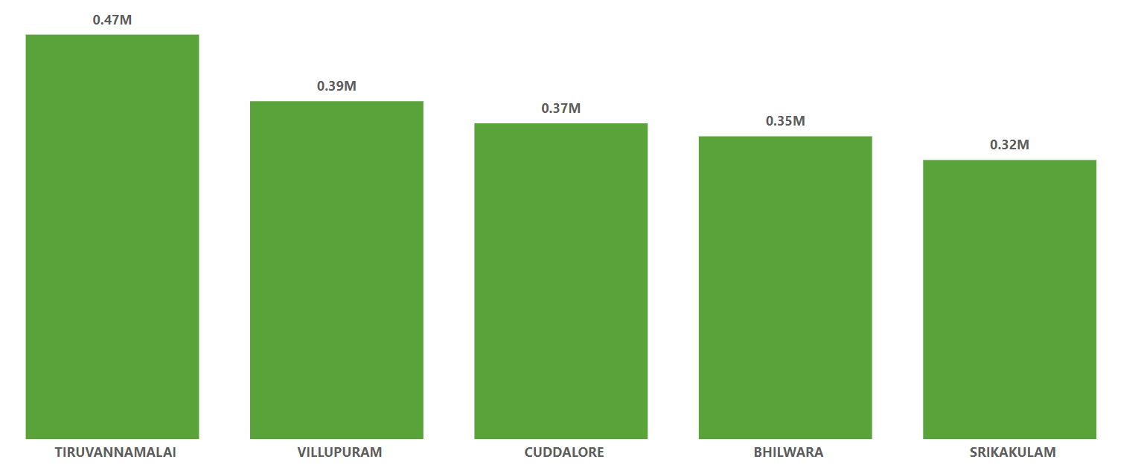
Top 5 Rural Households

Slide 5
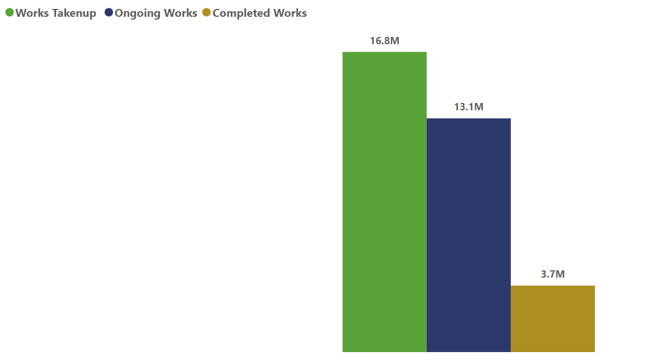
Work Progress

Slide 6
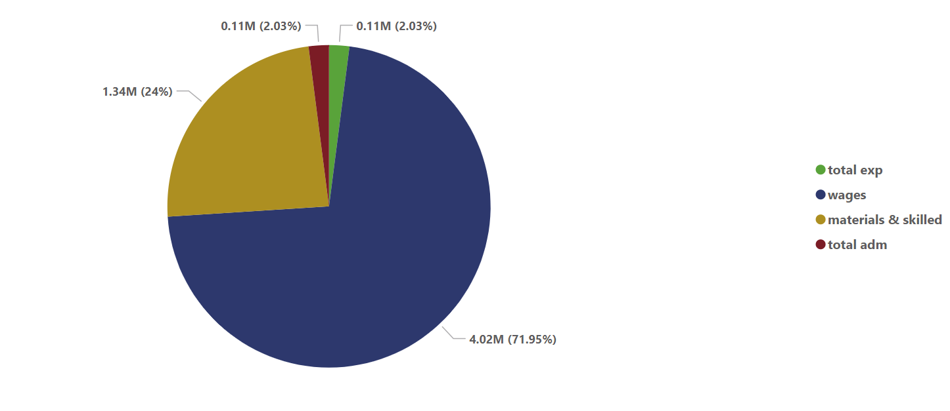
Expenditures

Slide 7
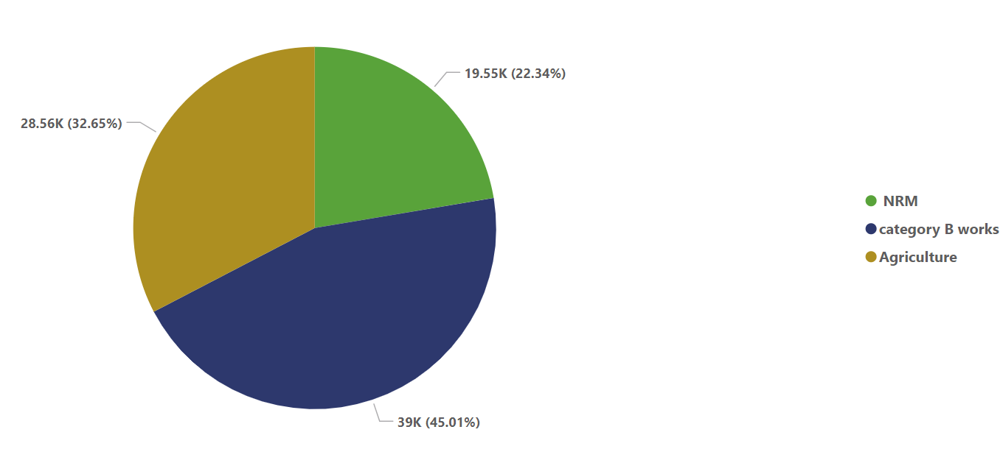
Expenditure on workers

Slide 8
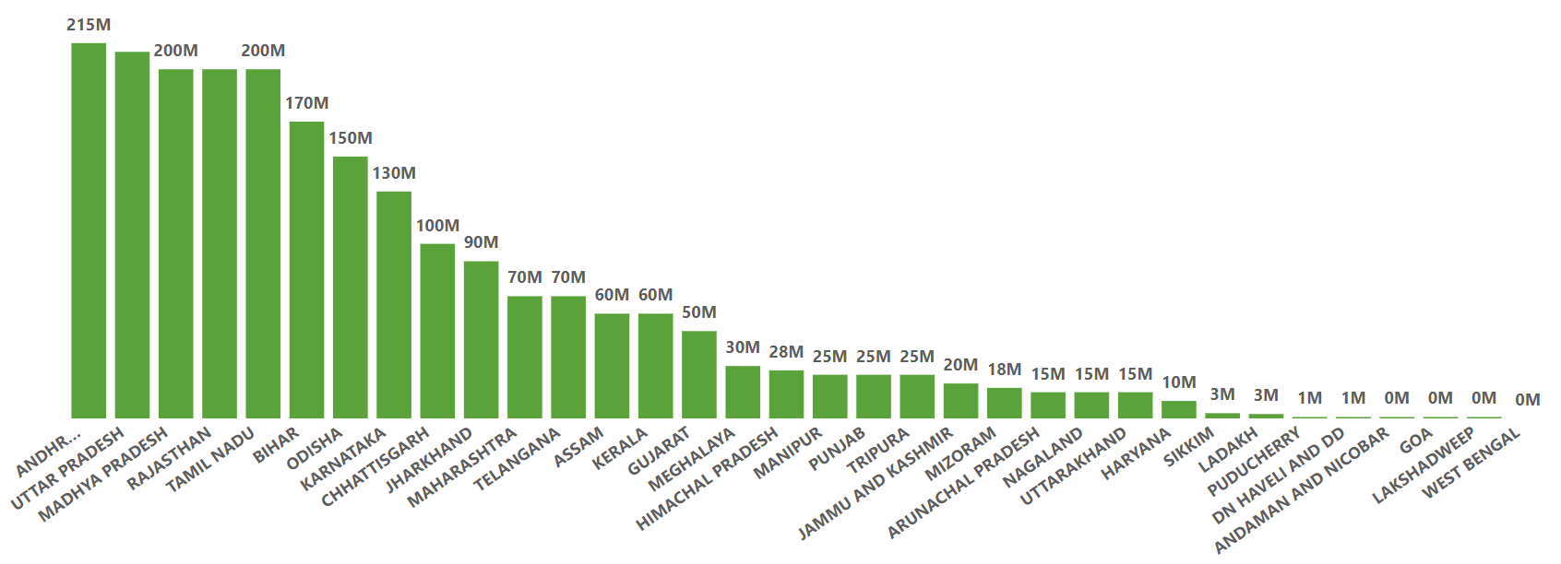
Labour Budget by states

Slide 9
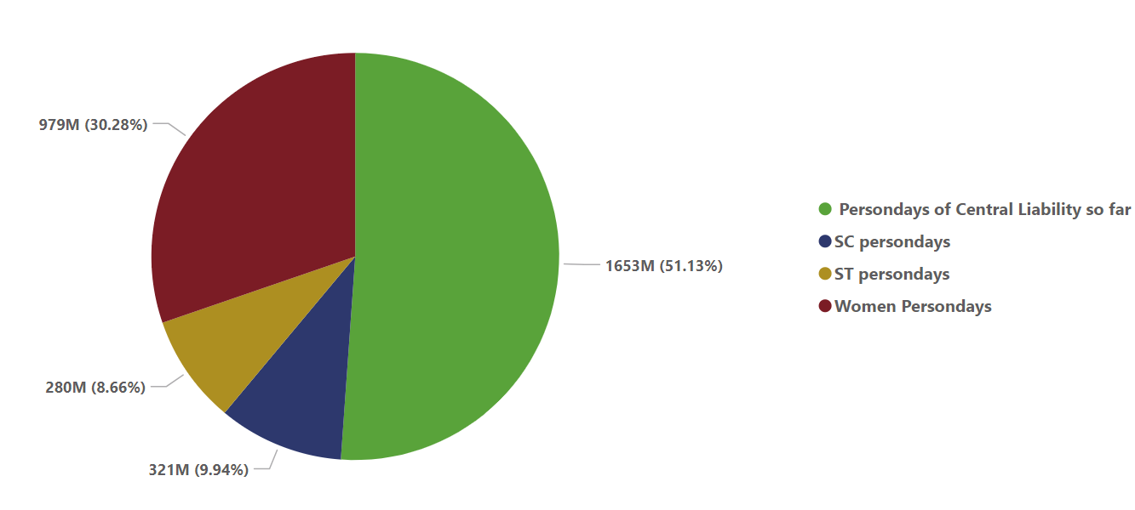
Persondays of Employements

Slide 10
Thank YOU…

